Slide 1
2019 BoD Meeting
Boston, MA
January 8 – January 9, 2019

Slide 2
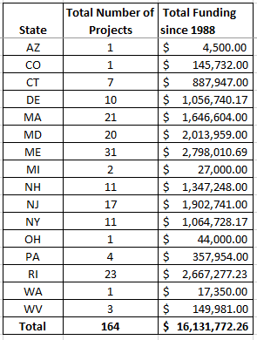
State Totals since 1988

Slide 3
State Totals since 1988

Slide 4
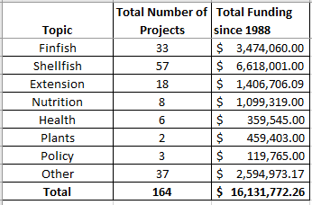
Totals by Topic

Slide 5
Totals by Topic

Slide 6
Projects by State - CT

Slide 7
Projects by State - DE

Slide 8
Projects by State - MA

Slide 9
Projects by State - MD

Slide 10
Projects by State - ME

Slide 11
Projects by State - NH

Slide 12
Projects by State - NJ

Slide 13
Projects by State - NY

Slide 14
Projects by State - PA

Slide 15
Projects by State - RI

Slide 16
Projects by State - WV

Slide 17
Topics Over Time

Slide 18
Topics Over Time

Slide 19
Topics Over Time Totals

Slide 20
Topic Over Time Totals

Slide 21
Topics 1988-1997

Slide 22
Topics 1998-2007

Slide 23
Topics 2008-2018

